Slide 1

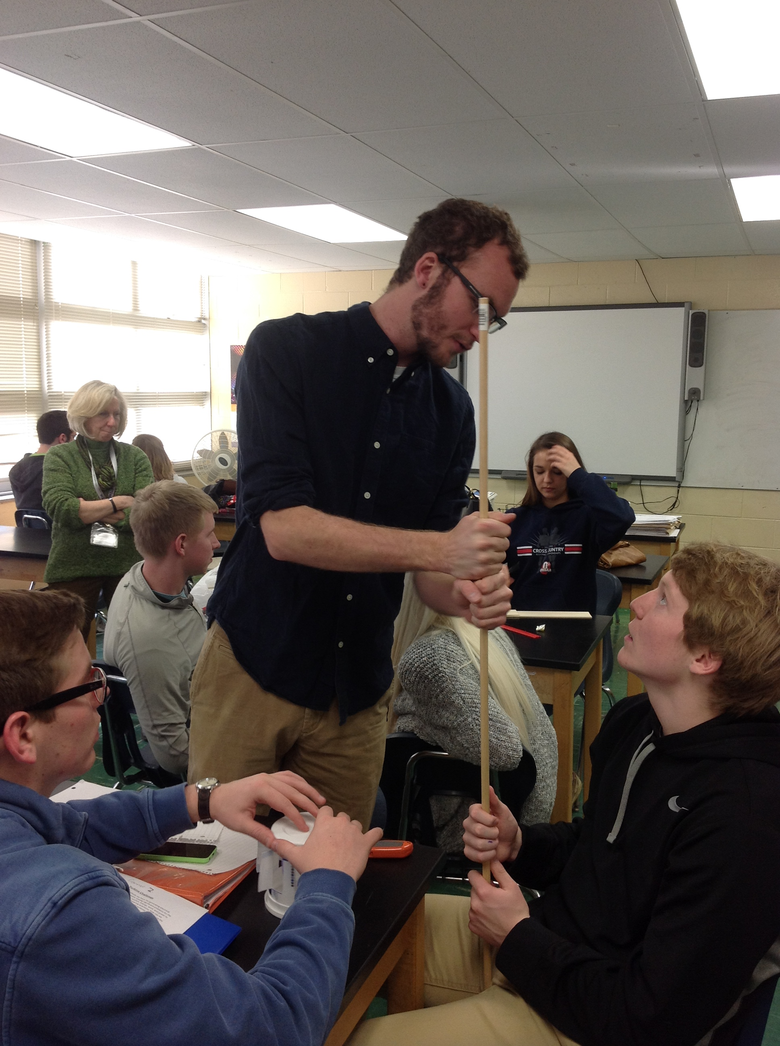
RET is funded by the National Science Foundation, grant # EEC 0808696.
Jake Holden
Aerospace Engineering Senior & COFSP Recipient
Finneytown High School: Amy Gunderman (RET)
12th Grade Honors Physics Class

Slide 2


Circular Motion, Power, Work and Energy
According to the New Ohio's New Learning Standards in Science, circular motion is taught in the Physics Course under the content topics of Forces, Momentum and Motion.

Slide 3
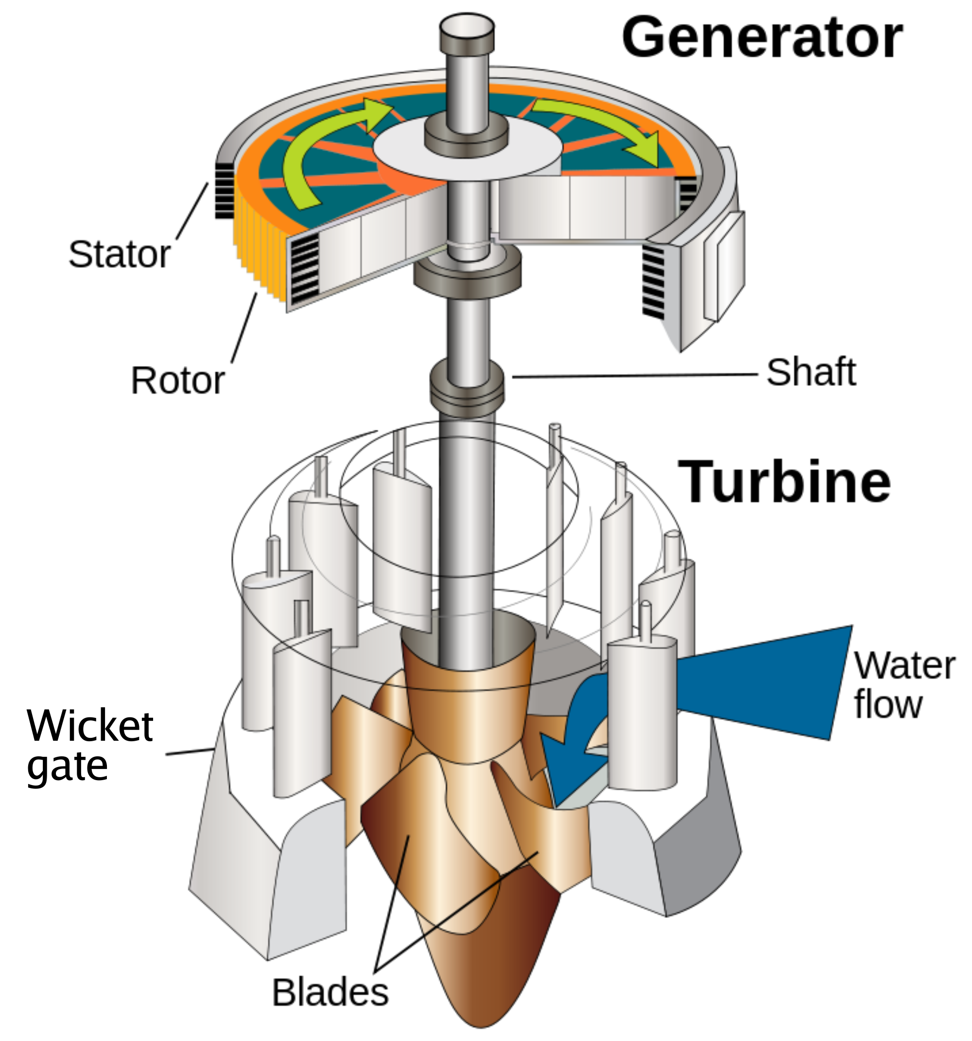
Water Turbine Challenge
Objectives:
Guiding Questions:
Explain why there is a need for renewable energy.
Construct the kinematics diagram of the water turbine .
Describe the effect of turbine blade design on power output.
Explain the benefit of water over air.
Why are fossil-fuels insufficient?
What are the components of a water turbine and how is each part involved in the rotational motion?
How do different blade shapes change the power output of a water turbine?
What are the benefits of hydro-power?

Slide 4
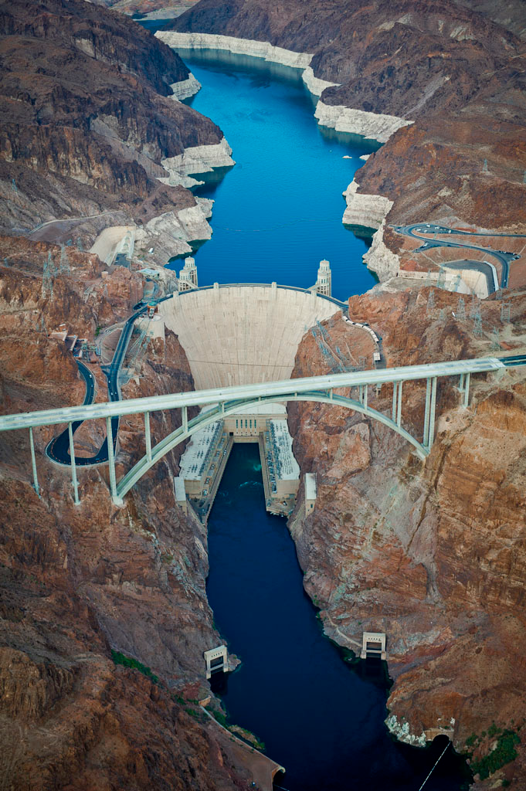
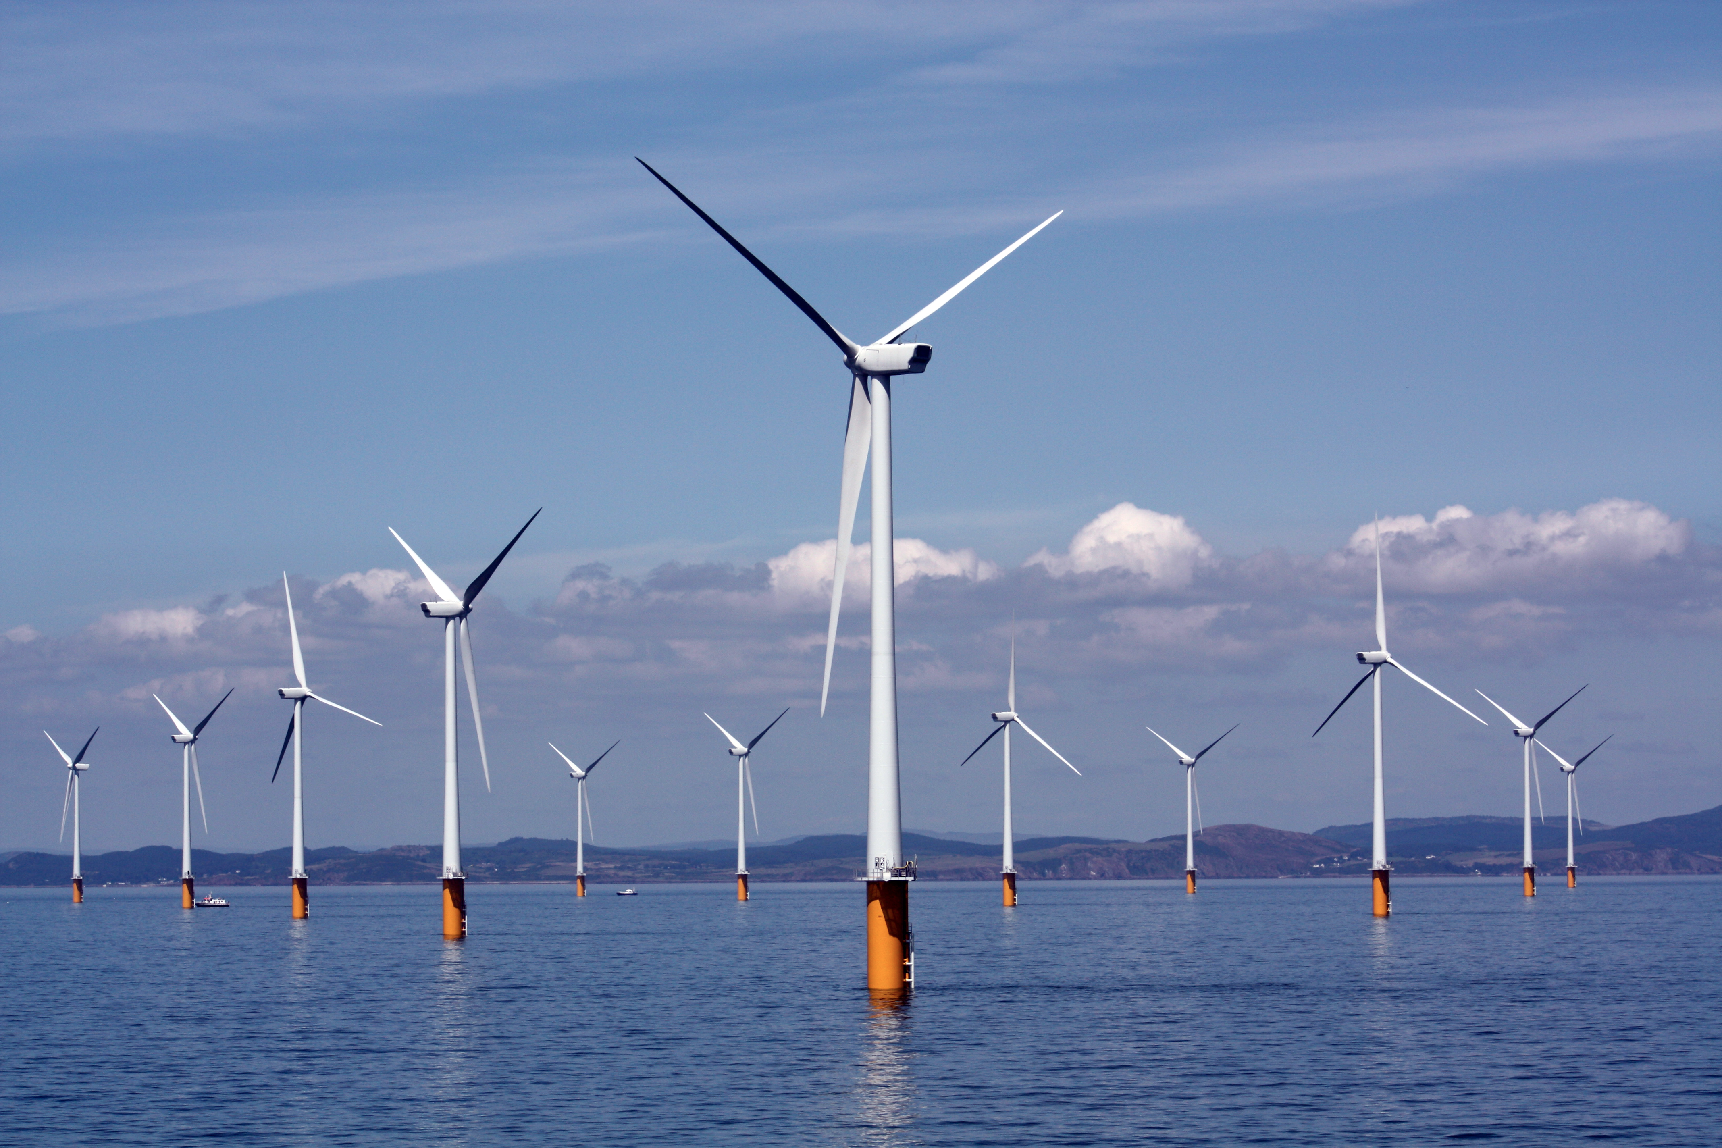
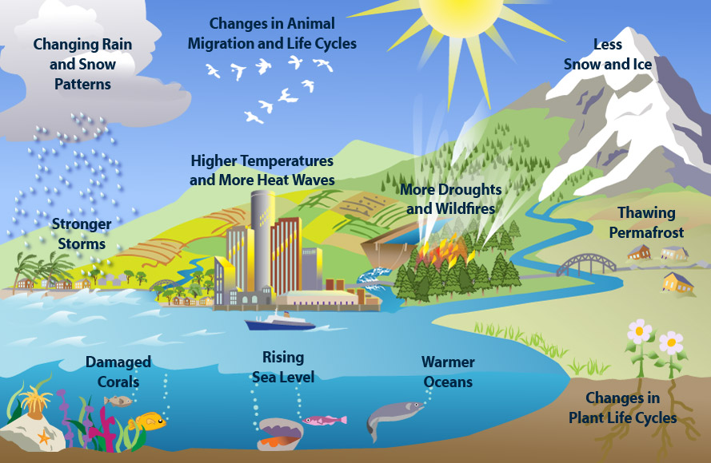
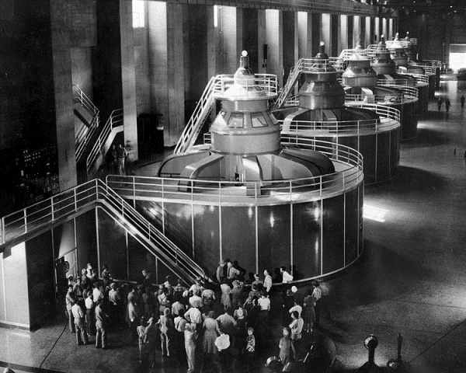
Applications, Careers, and Societal Impact

Slide 5
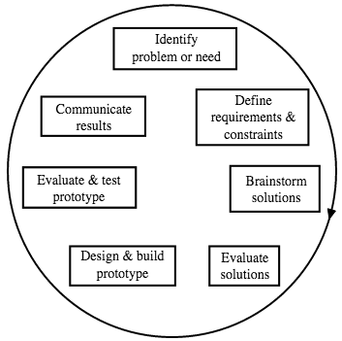
Evidence of Learning
Pre/Post testing shows a significant growth in understanding.
Checkpoint system throughout the EDP also allowed for critical formative assessments.

Slide 6
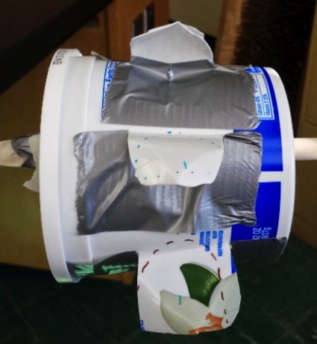
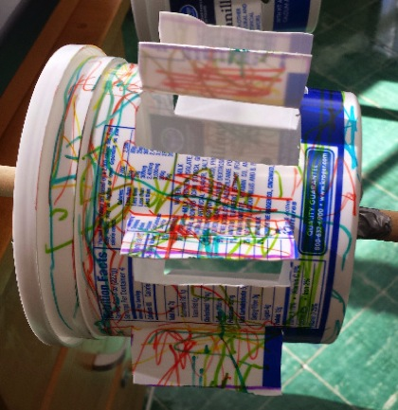
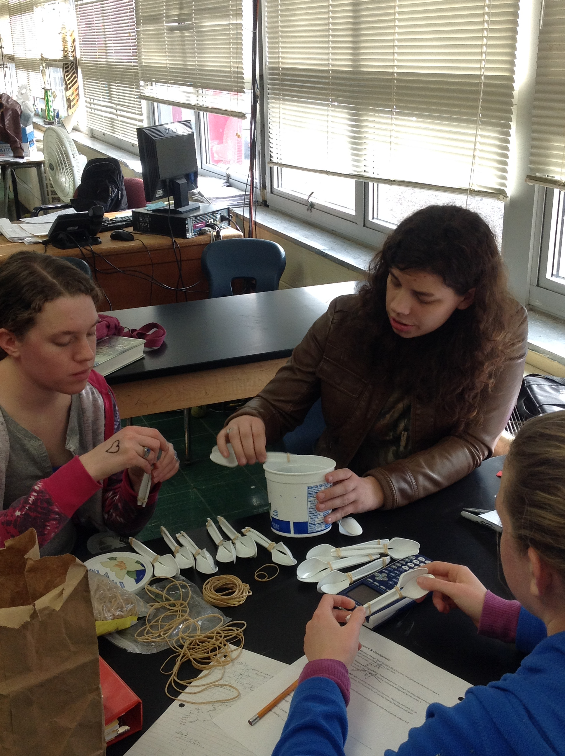
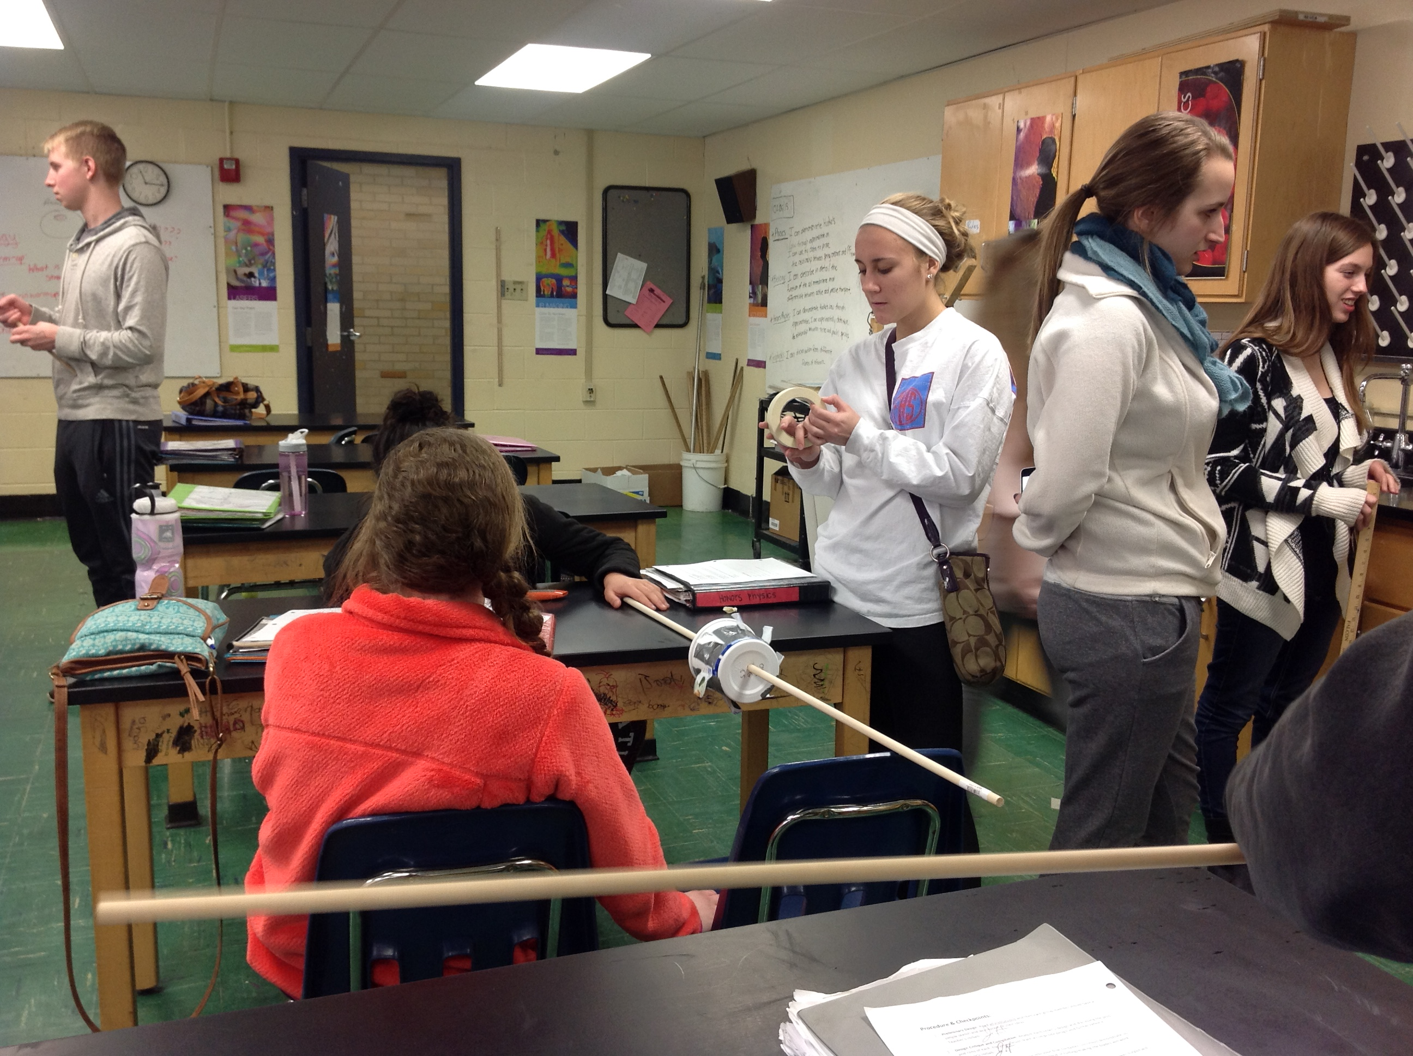
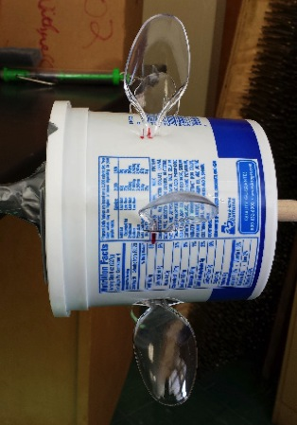
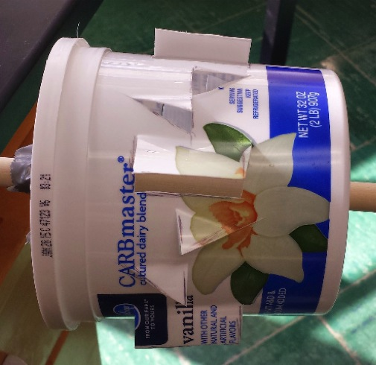
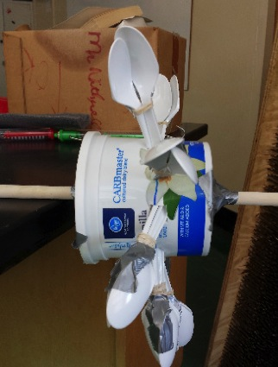
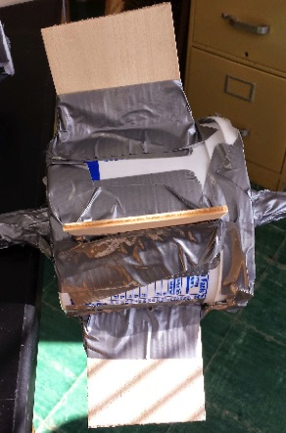
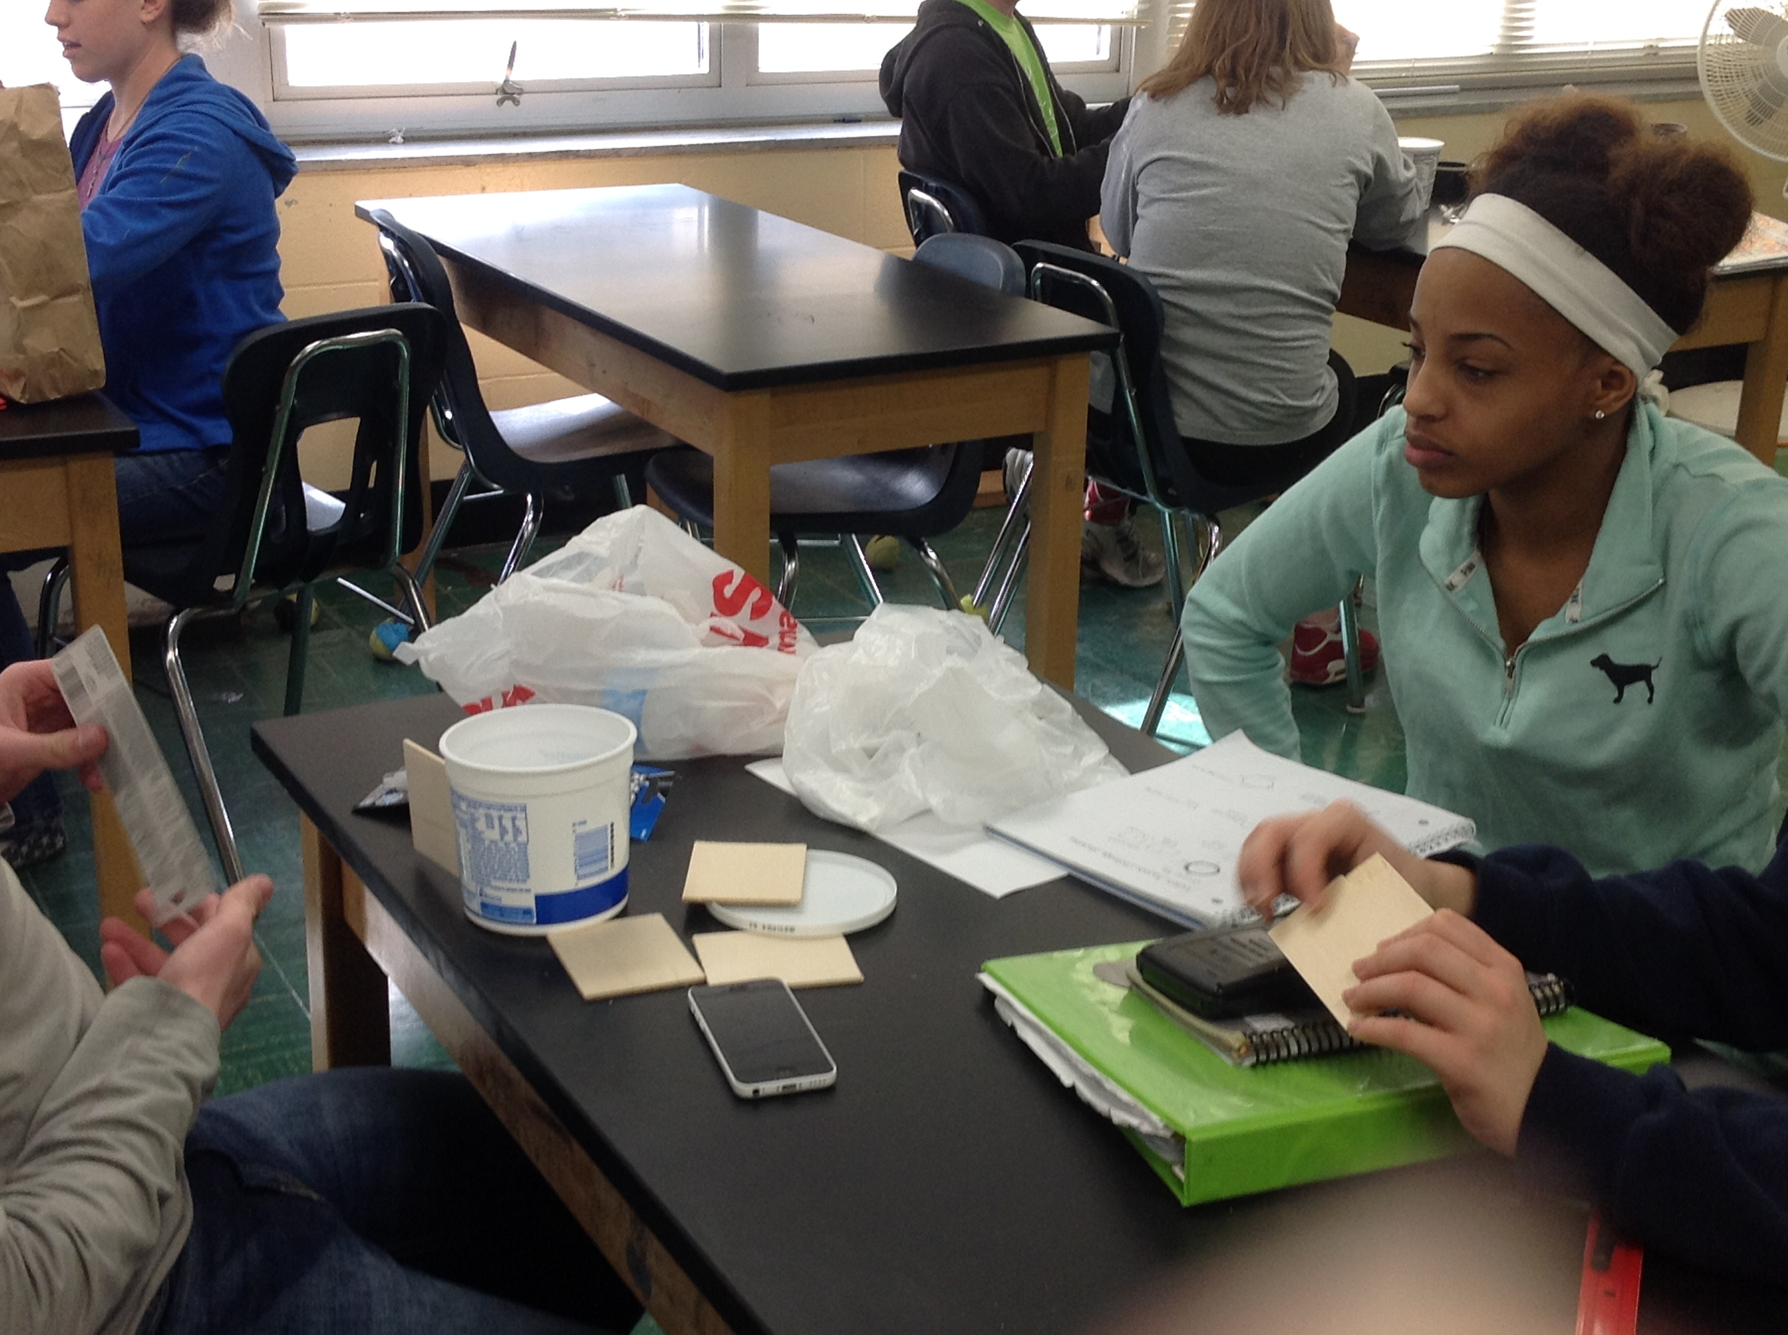
Student Engagement

Slide 7
Reflection
What I would change:
Turbine testing method – This process needs to be more secure and less time consuming.
Planning – The activity was originally planned for 2 periods and it took 4 to fully implement in reality.
Surprises:
Students immediately took the initiative to bring in extra building materials.
How students learn:
The friendly competition and open-endedness of this problem seemed to hook students immediately, and the CHECKPOINTS gave the structure needed to ensure that is was not intimidating.

